Slide 1
Dual Language Immersion
Chino valley unified school district
Notes:
This presentation is an overview of CVUSD’s plan for the implementation of the Dual Language Immersion Program planned to open in 2022-23

Slide 2
Welcome & Introductions
Mrs. Lisa Sura, Principal of Hidden Trails Elementary
Ibis Cordero, Parent Engagement Coordinator
Carol Sin, Bilingual Clerk at Hidden Trails Elementary
Mr. Brian Lee, Assistant Principal
Notes:
Sura

Slide 3
Hidden Trails – Meet the Office Staff
Principal- Lisa Sura
Assistant Principal- Brian Lee
Mandarin Translator- Carol Sin
Family Engagement Center- Ibis Cordero
Notes:
Mrs. Sura

Slide 4
Meet the Teaching Staff
Kindergarten
Mrs. Feng
Mrs. Zhang
First Grade
Ms. Bai
Mrs. Zhao
Second Grade
Ms. Chen (will start in August)
Mrs. Yuan (will start in August)
English
Mrs. Kang
Notes:
Mrs. Sura

Slide 5
Dual Language Immersion continues at Hidden Trails for the 2023-24 School Year for ENTERING KINDERGARTENERS (for students in CVUSD and other districts)
Mandarin
(Simplified in class Traditional optional for homework)
Notes:
Mrs. Sura

Slide 6
Chino Valley Unified School District’s Dual Language Program Mission
Offer students an enriching and challenging educational opportunity.
Students will learn to read, write, and communicate at high academic levels in Mandarin/English while achieving academic success in all content areas.
Students will develop the biliteracy skills and cross-cultural skills and competencies needed to succeed in our multi-cultural society and global economy.
Notes:
Mrs. Cordero

Slide 7
What is Dual Language?
Research has shown that it is an effective program for students to develop high literacy in English and the partner language
Students participating in Dual Language Immersion perform higher on state assessments, have higher college going rates, and have more career opportunities.
English speakers acquire Mandarin without risk to their academic achievement and English proficiency.
Notes:
Mrs. Cordero

Slide 8
Program Model
90-10 Model of Instruction
Kindergarten: 90% Mandarin and 10% English
First Grade: 90% Mandarin and 10% English
Second Grade: 80% Mandarin and 20% English
Third Grade: 70% Mandarin and 30% English
Fourth Grade: 60% Mandarin and 40% English
Fifth-Sixth Grade: 50% Mandarin and 50% English
Notes:
Mrs. Sura
“Partner Language” CVUSD is adopting the 90-10 model because research has shown that this model is the best in acquiring and sustaining a second language.

Slide 9
Site Schedule for Kindergarten –2023-2024
Gate opens for A.M. class at 7:40
A.M. Kindergarten 7:40 -11:10
Gate opens for P.M. class at 11:10
P.M. Kindergarten 11:10 – 2:30
Notes:
Mrs. Sura

Slide 10
90:10 Model-Instructional Schedule
GRADE | MANDARIN (Simplified and Traditional) | ENGLISH
Kinder | 90% (Language Arts, Math, Social Studies, P.E.) | 10% (ELD) *English teacher
1st | 90% (Language Arts, Math, Social Studies, P.E.) | 10% (ELD) *English teacher
2nd | 80% (Language Arts, Math, Social Studies, P.E.) | 20% (ELD and Science)
3rd | 70% (Language Arts, Math, Social Studies, P.E.) | 30% (Language Arts, ELD and Science)
4th | 60% (Language Arts, Social Studies, P.E.) | 40% (Language Arts, ELD, Science and Math
5th | 50% (Language Arts, Social Studies, P.E.) | 50% (Language Arts, ELD, Science and Math
6th | 50% (Language Arts, Social Studies, P.E.) | 50% (Language Arts, ELD, Science and Math
Notes:
Mrs. Sura

Slide 11
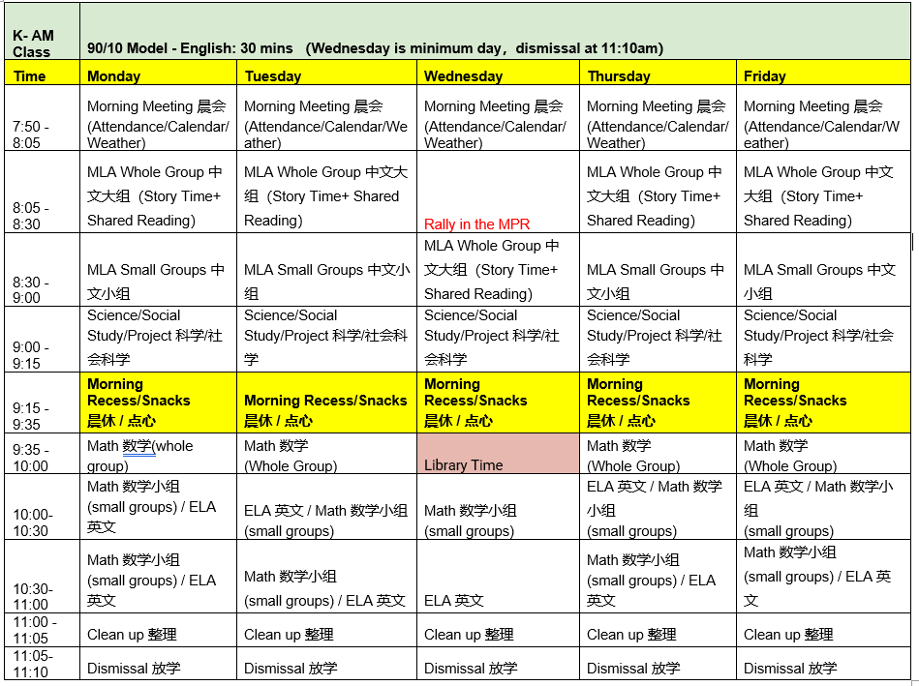
Notes:
Sylvia and Lucy

Slide 12
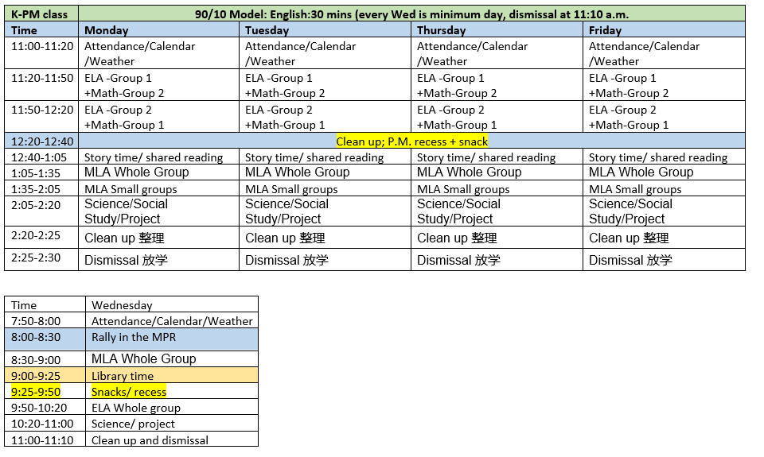
Notes:
Sylvia and Lucy

Slide 13
It’s a Commitment . . .
I understand that in the DLI program begins in Kindergarten and 1st grade with 90% of the instruction in Mandarin and will transition to 50% of the instruction in Mandarin in 5th grade.
I understand that strong native language skills are an excellent predictor of success in an immersion program. My child has not had difficulties with language development, and I believe that my child has strong native language skills.
I understand that for the first few weeks my child may not understand what the teacher is saying, and this could cause some frustration and stress if my child is a native English or language other than Mandarin speaker. I believe my child will be able to cope with this situation and adjust accordingly.
I understand that the Dual Language Immersion program is designed for a minimum of a seven-year period and removing my child from the program, particularly in the earlier years (grades K-3) could require supplementary tutoring for my child to transition successfully into an English program if removed. The district will likely not provide this necessary tutoring.
Notes:
Sura

Slide 14
It’s a Commitment . . .
I understand that the more exposure my child has to Mandarin the faster language is acquired. I will seek opportunities outside school to provide further Mandarin language exposure to my child, through books, events, arranging cross-language play opportunities, etc.
I understand that even if I don’t speak Mandarin, demonstrating a supportive attitude of interest and enthusiasm for Mandarin language and Chinese culture will have an important influence on my child’s interest and success. It is important that both parents/guardians agree to support entry into the Dual Language Immersion program.
I understand that a STEP meeting will be held with administration to discuss an exit strategy, if we decide that we no longer want our child in the Dual Language Immersion program.
I understand family involvement is highly correlated with success at school. I will support my child academically, even if I don’t speak or understand Mandarin, by showing interest in school, assuring that homework is completed, reading together (in any language), and communicating with the teacher.
Notes:
Sura

Slide 15
It’s a Commitment . . .
I understand that the students in the Dual Language Immersion are held to the same academic standards and will be required to do the same assessments as the students in English-only classrooms.
If my child is discovered to have learning problems which are making success in the program very difficult, I will agree to have him/her reassigned to an English classroom if it is academically appropriate. I understand that my child will receive Response to Intervention (RtI) in the areas off need in Mandarin and/or English after a universal screening is etermined.
I understand that family involvement is one of the strengths of the Dual Language Immersion program. I and/or a family member will be actively involved at Hidden Trails through classroom volunteering, projects, committees, or organizations, such as the PTO (Parent Teacher Organization), ELAC, or SSC.
I understand that all families have a shared responsibility with the school as stated in the included Home School Compact brochure.
Notes:
Sura

Slide 16
Second Language Acquisition
Notes:
Mrs. Sura

Slide 17
Goals to work on prior to Kindergarten
I can drink from a cup, open a juice box, and use eating utensils
I can use the restroom and wash my hands
I know my parent's names and my address
I cover my mouth when I sneeze or cough
I can get my jacket on and off without help
I know how I'm going to get to and from school
Notes:
Mrs. Cordero

Slide 18
Top Ten Tips for Parents (in English or Chinese)
Read together every night where your child can follow along
Practice identifying numbers and counting objects
Talk about colors in real life or in books
Encourage your child to speak clearly and full sentences
Encourage use of fine motor skills: scissors, clay, playdoe, coloring
Visit the library
Watch "Fun, Fun, Elmo" You Tube to support mandarin immersion
Use Google Translate from your phone while listening to Mandarin
Give your child 2 or 3 step directions and ask them to repeat it back
Practice cleaning up
Notes:
Mrs. Cordero

Slide 19
Little Sponges
This resource will be available to all DLI students.
There will be a parent training at a later date.
https://www.little-sponges.com/index.php/topic/forest-adventure-watch-learn-chinese-sample/
Notes:
Sura

Slide 20
Enrolling your Child
Add site process here

Slide 21
Start of School: Important Dates
Post Cards will be sent out in July to let families know whether their child was placed in an a.m. or p.m. class. We will work collaboratively with Fun Club to determine placement.
If you have not received your postcard by July 27th, please contact the school.
Back to School Night will be Wednesday, August 23rd.
Notes:
Lee

Slide 22
Process for knowing my child's teacher
Teacher Meet and Greet will be held Friday, August 4th from 9:00-10:00. You will find out who your child's teacher is on this day.
Back to School Night will be Wednesday, August 23rd.
Parent Conferences will be held in late September/early October
Teachers can be reached by email.
Xiaohui_zhang@chino.k12.ca.us
Hanrong_feng@chino.k12.ca.us
Notes:
Lee

Slide 23
School Tour: What you will see . . .
Classrooms
Playground
Restrooms

Slide 24
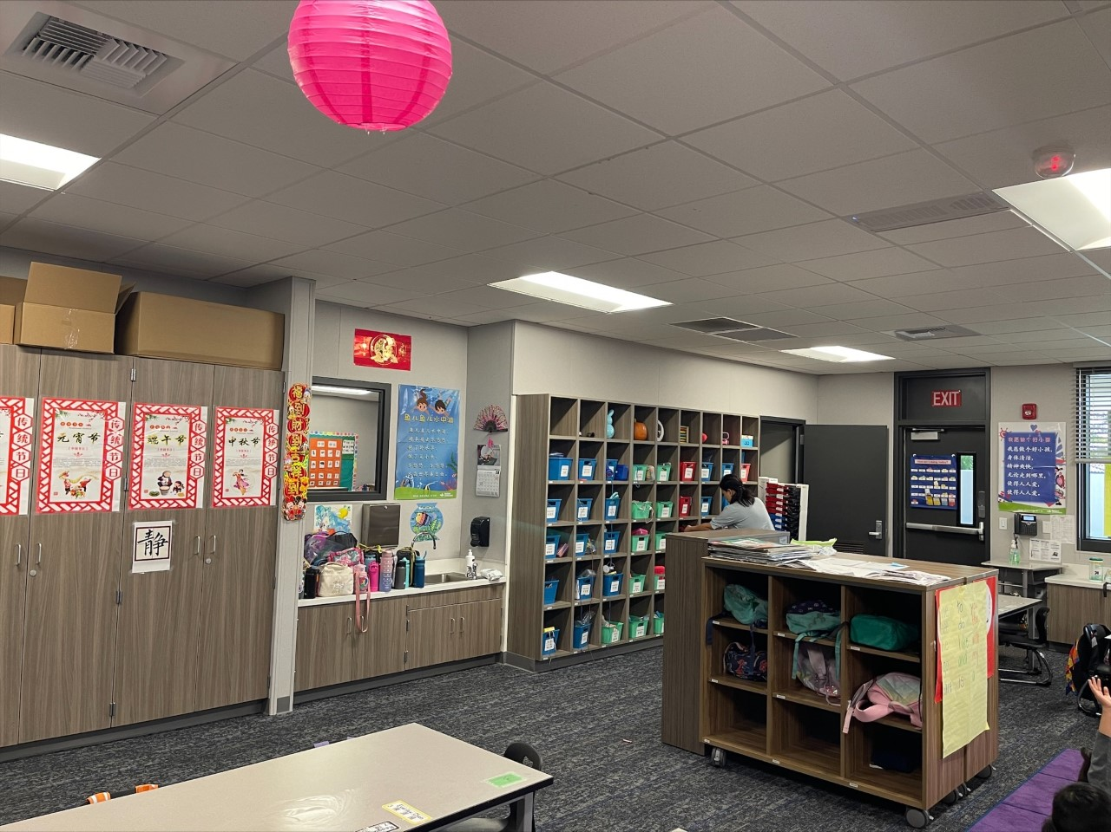
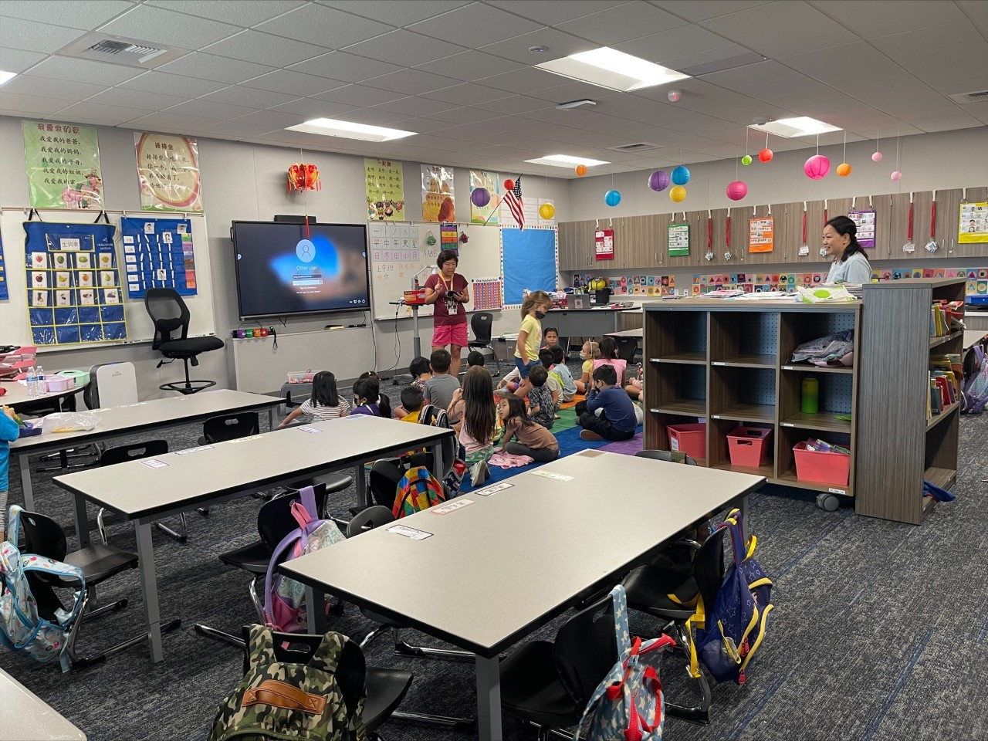
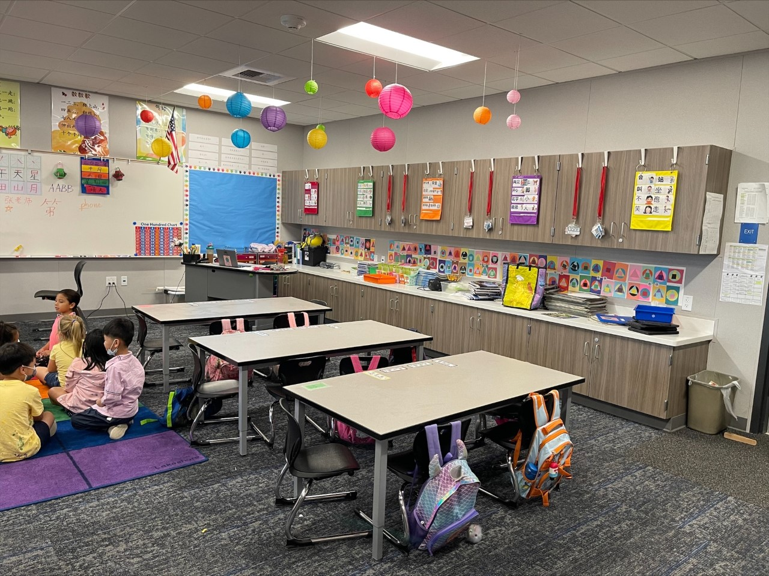
Pictures of the Classroom
Notes:
Mrs. Sura

Slide 25
Notes:
Dr. Ayers
We will take a few questions at this time. The questions that we do not answer will be on the website where you registered.

